Slide 1
Used Car Price Prediction

Slide 2
Contents
Problem Statement
Definition
Benefits of Customer Retention
EDA Steps
Visualizations
Analysis
Conclusion
Limitation

Slide 3
Problem Statement
With the covid 19 impact in the market, we have seen lot of changes in the car market. Now some cars are in demand hence making them costly and some are not in demand hence cheaper. One of our clients works with small traders, who sell used cars. With the change in market due to covid 19 impact, our client is facing problems with their previous car price valuation machine learning models. So, they are looking for new machine learning models from new data. We have to make car price valuation model. This project contains two phase Data Collection Phase :
1.Data Collection Phase.
2.Model Building Phase.

Slide 4
Definition
The Indian automotive sector was already struggling in FY20. before the Covid-19 crisis. It saw an overall degrowth of nearly 18 per cent. This situation was worsened by the onset of the Covid-19 pandemic and the ongoing lockdowns across India and the rest of the world. These two years (FY20 ,FY21 and FY22) are challenging times for the Indian automotive sector on account of slow economic growth, negative consumer sentiment, BS-VI transition, changes to the axle load norms, liquidity crunch, low-capacity utilization and potential bankruptcies.
The COVID-19 pandemic has had a swift and severe impact on the globally integrated automotive industry. Symptoms include a disruption in Chinese parts exports, large scale manufacturing interruptions across Europe, and the closure of assembly plants in the United States. This is placing intense pressure on an industry already coping with a downshift in global demand, and likely leading to increased merger & acquisition activity.

Slide 5
Benefits of Used Car Price Prediction Use Case
Improved market penetration
Enhanced control over the distribution
Lower transaction failure rate
Better loyalty of resellers
Revenue addition
Service continuation
Highly robust platform with strong support

Slide 6
Exploratory Data Analysis(EDA)
Imported necessary libraries and loaded the dataset.
Checked null values. There is 81 null values in TRANSMISSION column. Since it is a categorical column, so I have replaced null values with mode.
Formatted column DRIVEN_KM and PRICE, replace km, Rs, leading and trailing spaces.
4.Performed both univariate and bivariate analysis and visualized each feature using seaborn and matplotlib libraries by plotting count plot, scatter plot, dist plot, and box plots.

Slide 7
Data and Assumptions
The given data contains 8668 rows and 10 columns.
2. Columns and their description are as follows:
‘LOCATION’: This describes at which location , car is available for sell.
‘MNF_YEAR: Car Manufacturing Year.
‘BRAND’: Brand is manufacturer name.
‘MODEL’: model of the car.
‘VARIANT’: Variant is description of model.
‘TRANSMISSION’: Gear Shift variant is (Automatic, Manual, Semi-Automatic)
‘DRIVEN_KM’: No of kilometres driven before selling.
‘FUELTYPE’: Petrol, Diesel, Petrol + CNG, Petrol + LPG
NO_OF_OWNERS: 1st ,2nd or 3rd owner of the car
PRICE: Target variable that tells what is the price of used car.

Slide 8
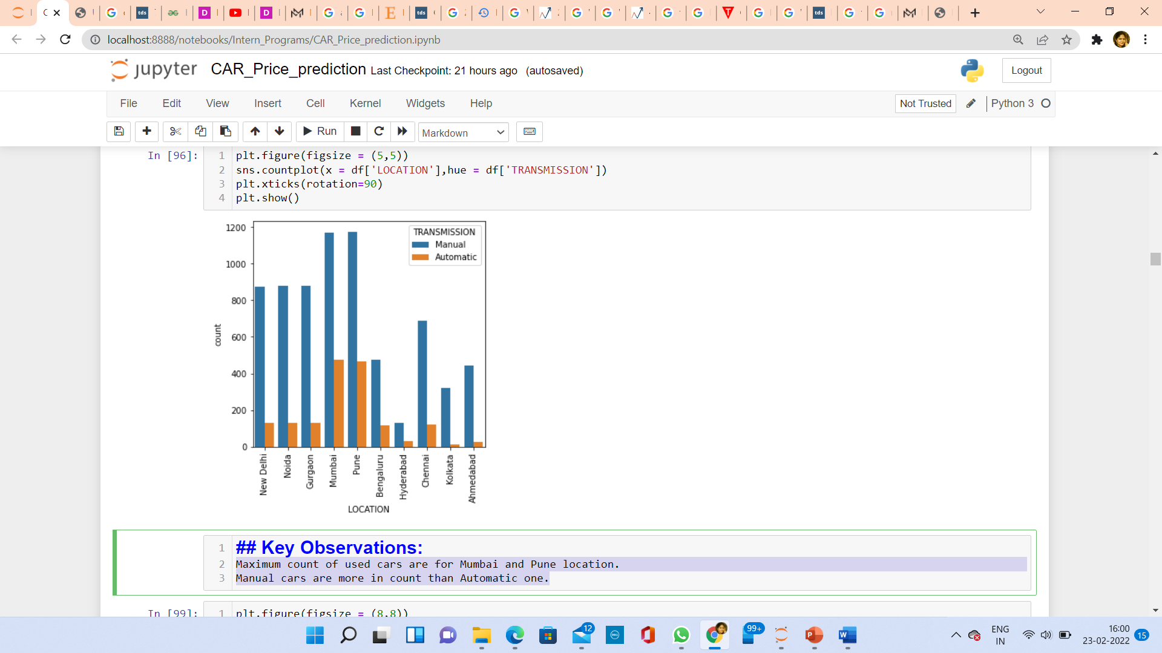
Visualization(Univariate Analysis)
Observations:
Maximum count of used cars are for Mumbai and Pune location.
Manual cars are more in count than Automatic one.

Slide 9
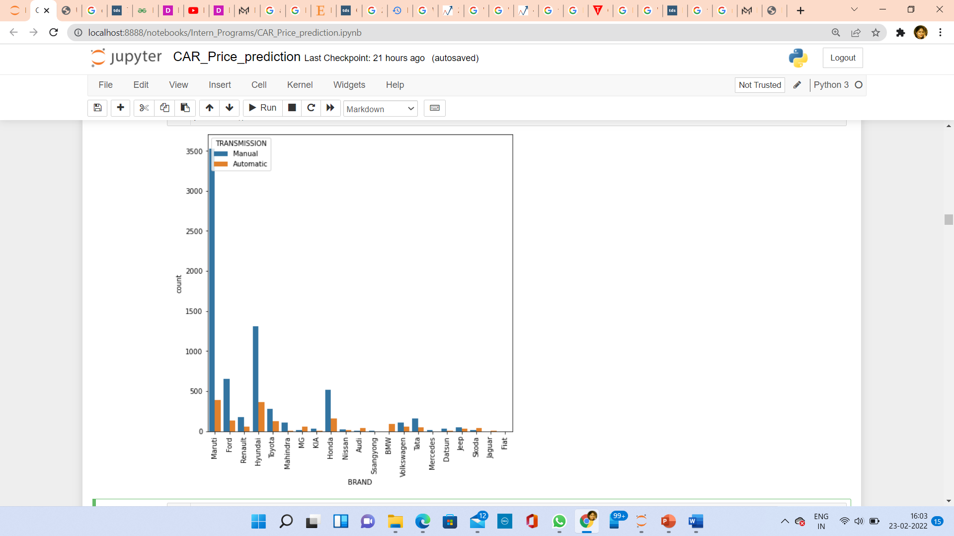
Visualization(Univariate Analysis)
Observations:
For used cars ,The most demanded brand is Maruti followed by Hyundai and Honda.
Manual cars are more in count means more in demand than Automatic.

Slide 10
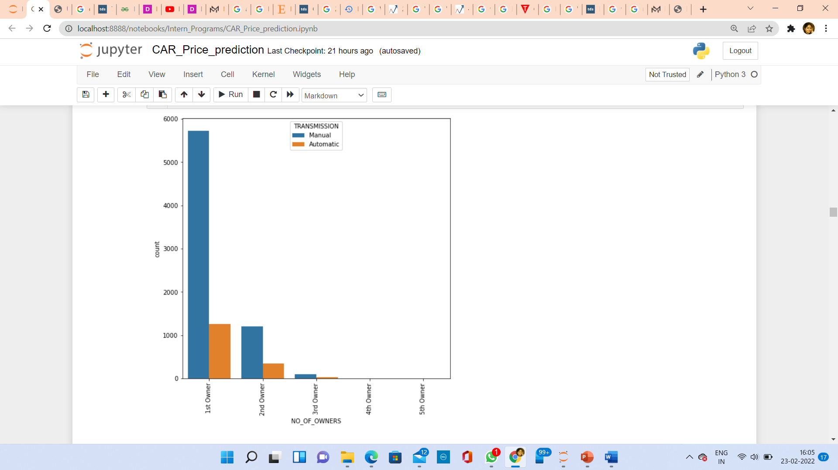
Visualization(Univariate Analysis)
Observations:
No one wants to become 4th owner or 5th owner. Very less people wants to become 3rd owner. Every one wants to be 1st owner.
Manual cars are more in count than automatic cars.

Slide 11
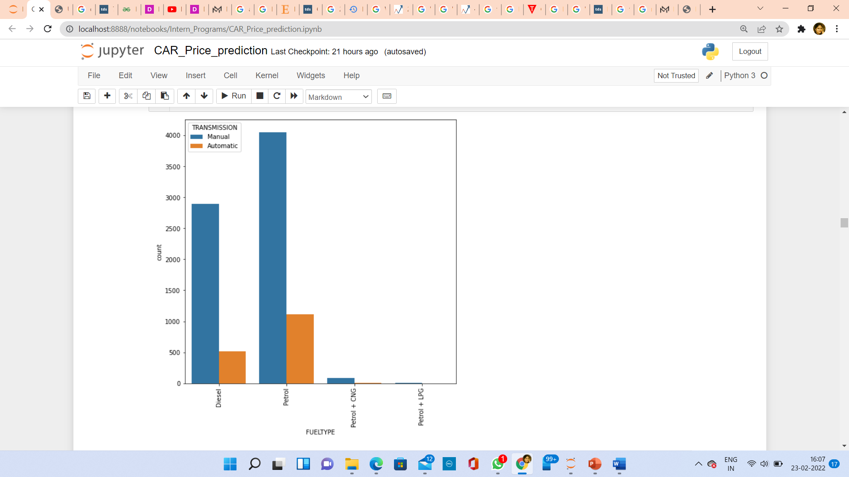
Visualization(Univariate Analysis)
Observations:
Petrol cars are more in counts followed by Diesel cars.
Manual cars are more in counts than automatic one.

Slide 12
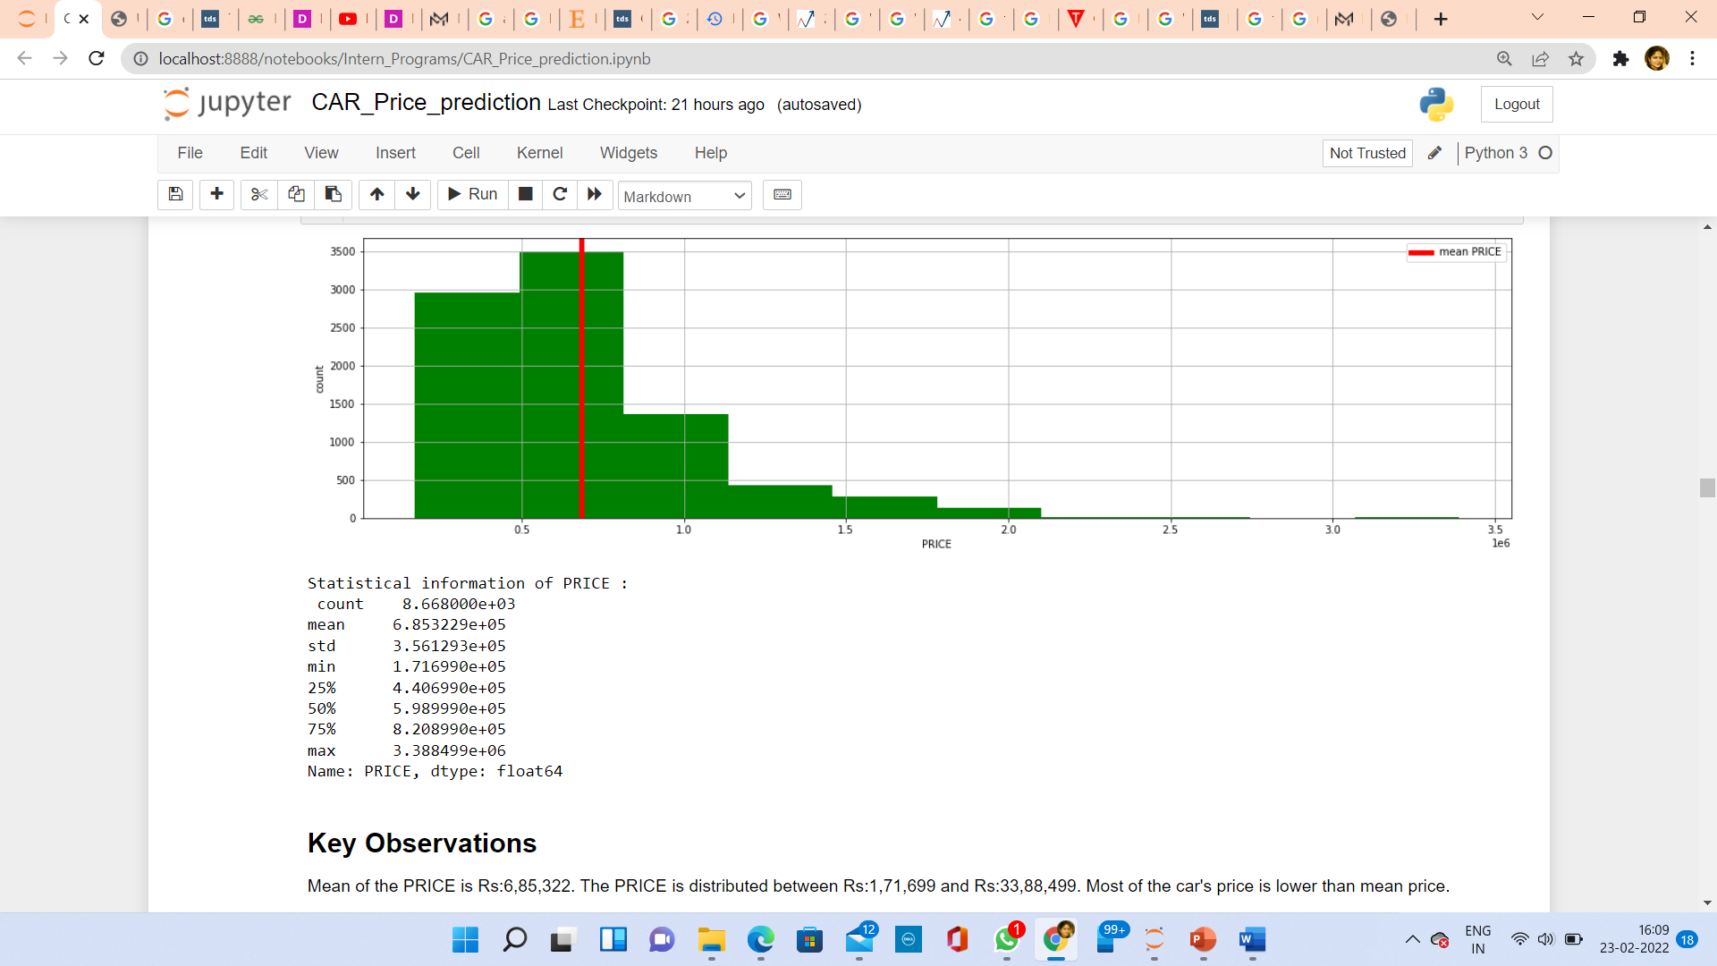
Visualization(Univariate Analysis)
Observations:
Mean of the PRICE is Rs:6,85,322.
The PRICE is distributed between Rs:1,71,699 and Rs:33,88,499.
Most of the car's price is lower than mean price.

Slide 13
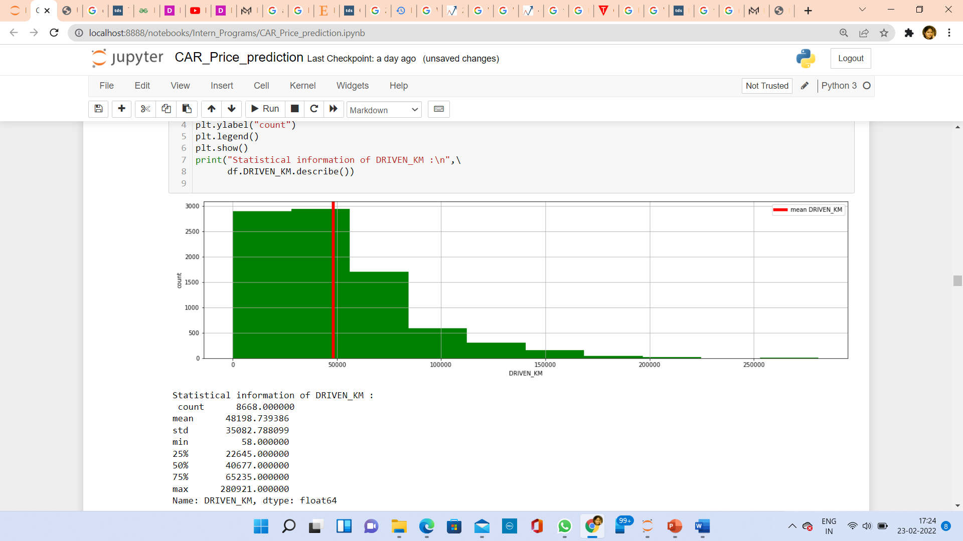
Visualization(Univariate Analysis)
Observations:
Minimum driven km is 58 km and Maximum driven km is 280921 km.
Mean of driven km is 48198 km and most values are under 50,000 km.

Slide 14
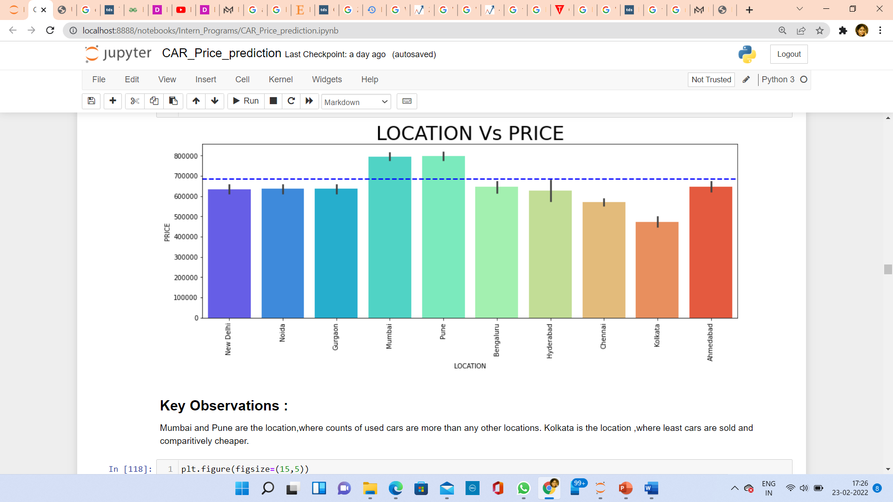
Visualization(Bi-Variate Analysis)
Observations:
Mumbai and Pune are the location, where counts of used cars are more than any other locations.
Kolkata is the location ,where least cars are sold and comparatively cheaper.

Slide 15
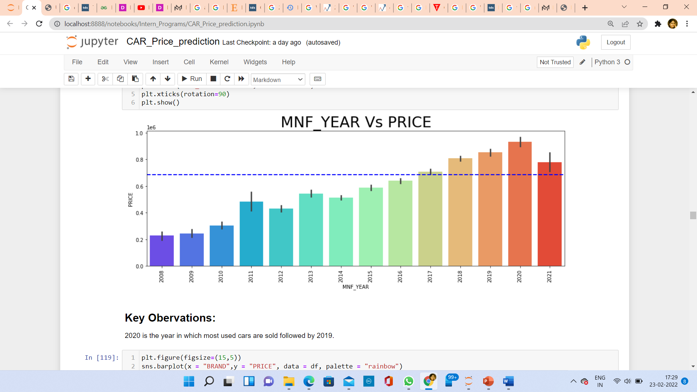
Visualization(Bi-Variate Analysis)
Observations:
2020 is the year in which most used cars are sold followed by 2019.

Slide 16
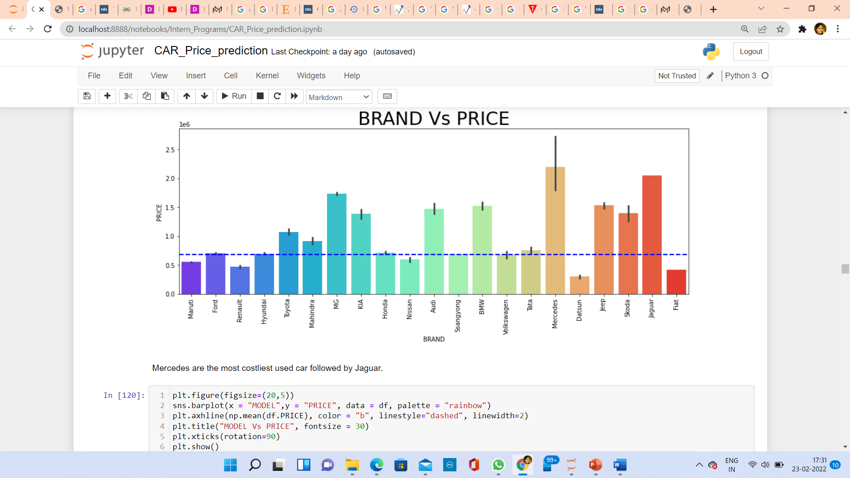
Visualization(Bi-Variate Analysis)
Observations:
Mercedes are the most costliest used car followed by Jaguar.

Slide 17
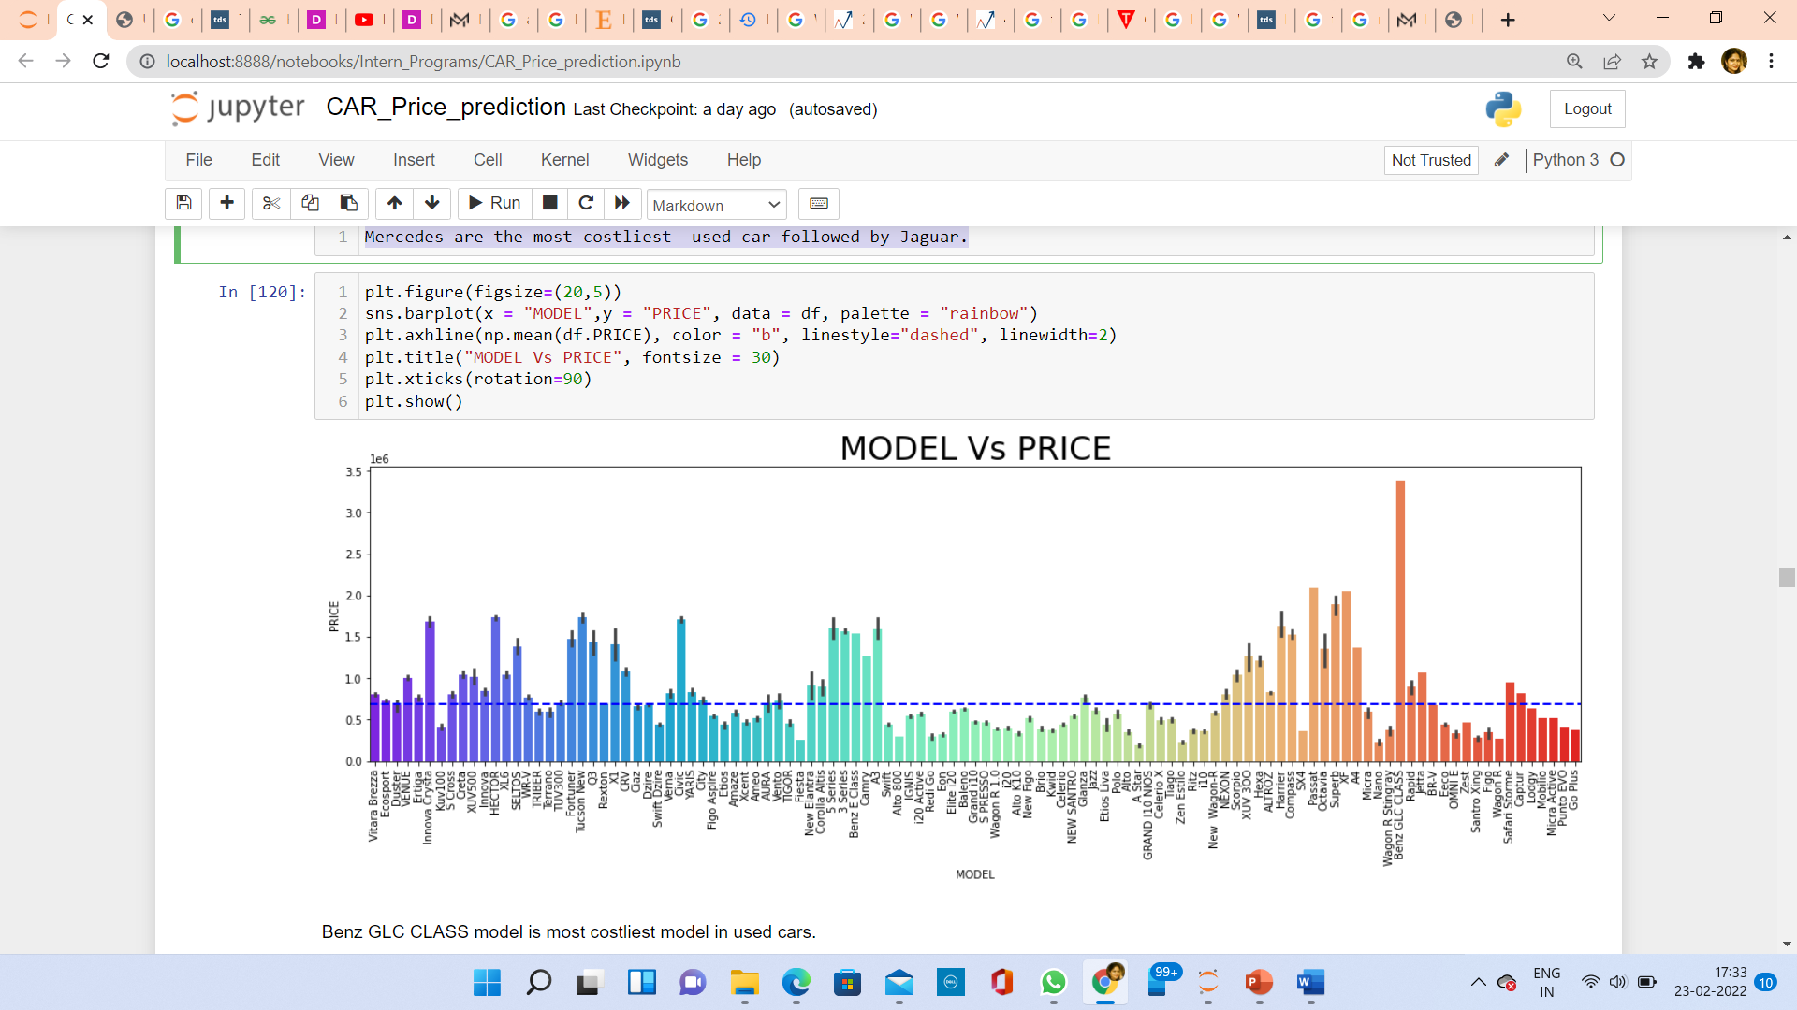
Visualization(Bi-Variate Analysis)
Observations:
Benz GLC CLASS model is most costliest model in used cars.

Slide 18
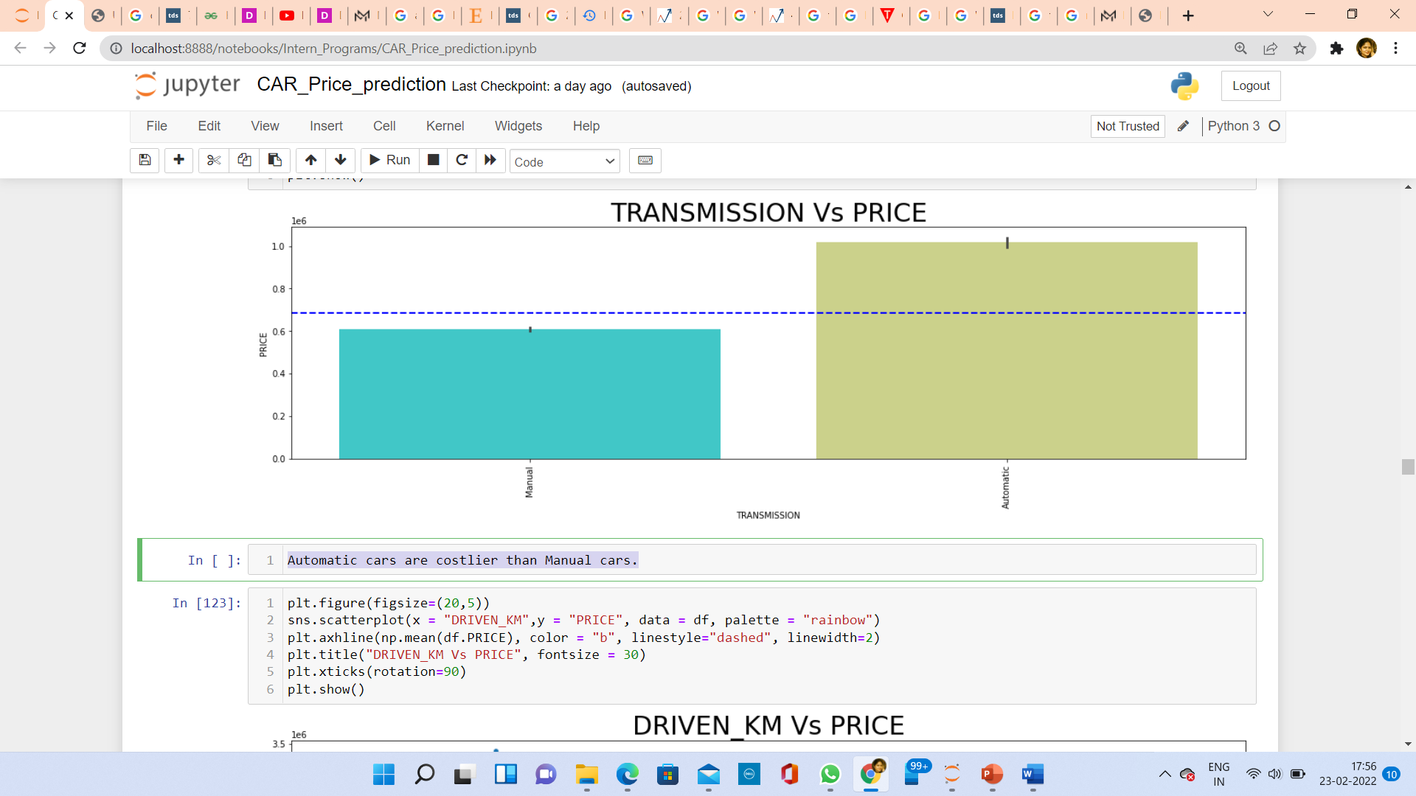
Visualization(Bi- Variate Analysis)
Observations:
Automatic cars are costlier than Manual cars.

Slide 19
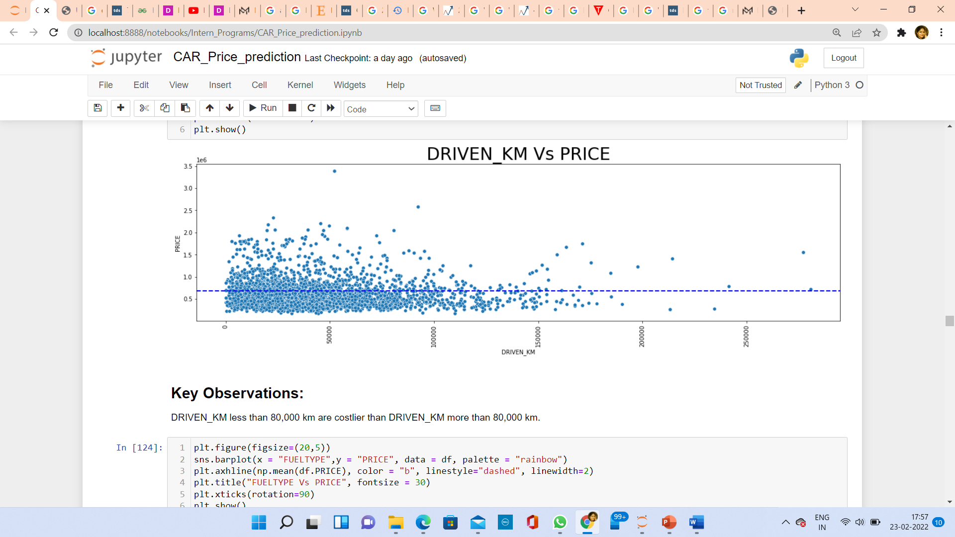
Visualization(Bi-Variate Analysis)
Observations:
DRIVEN_KM less than 80,000 km are costlier than DRIVEN_KM more than 80,000 km.

Slide 20
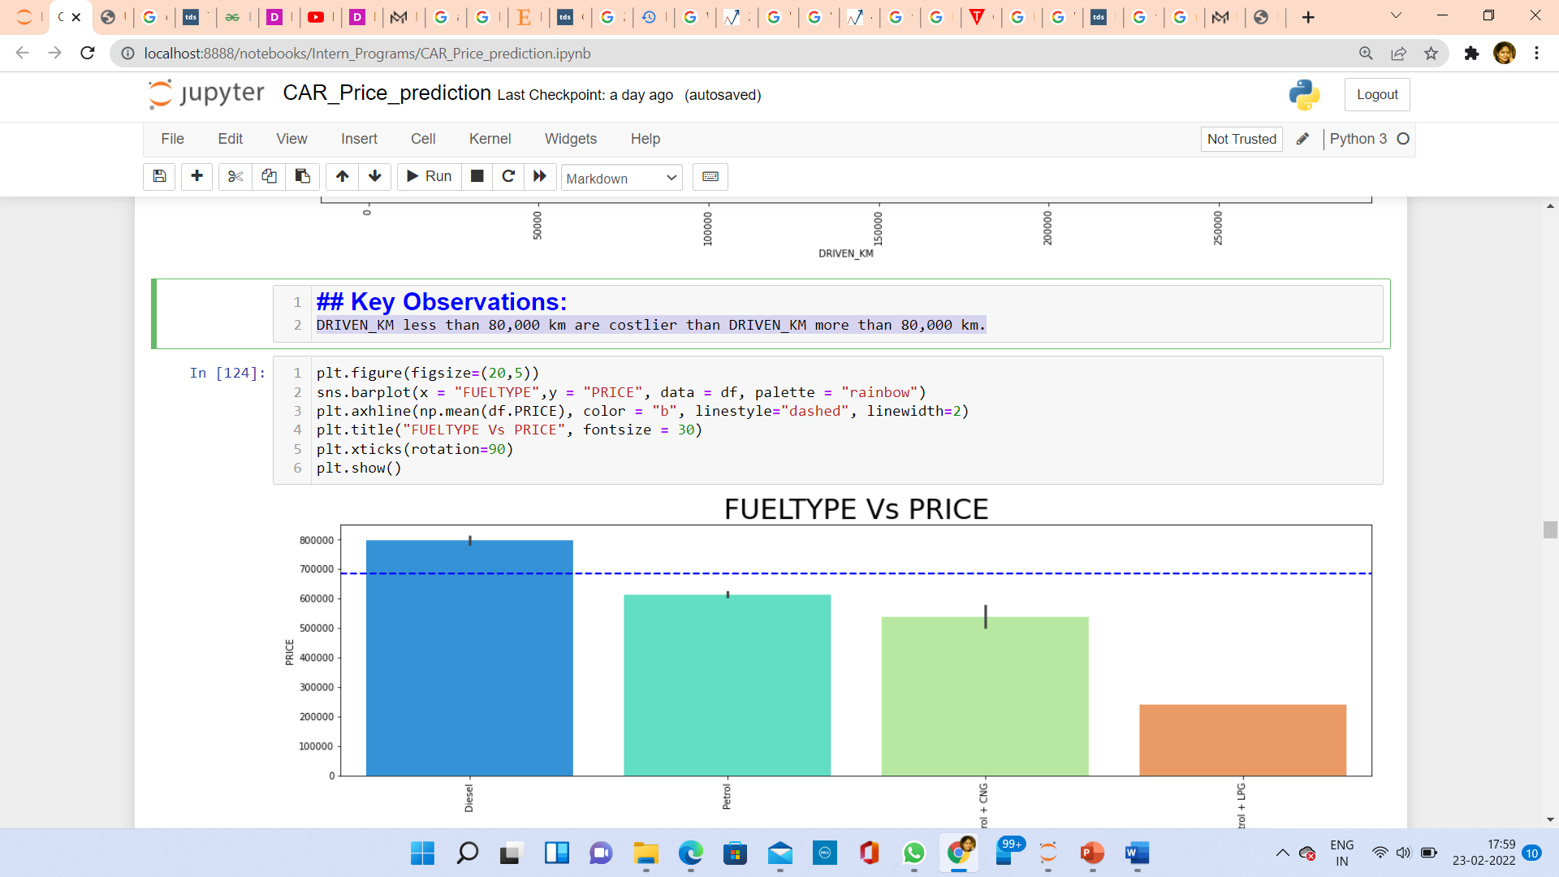
Visualization(Bi- Variate Analysis)
Observations:
Diesel cars are costlier than petrol cars.

Slide 21
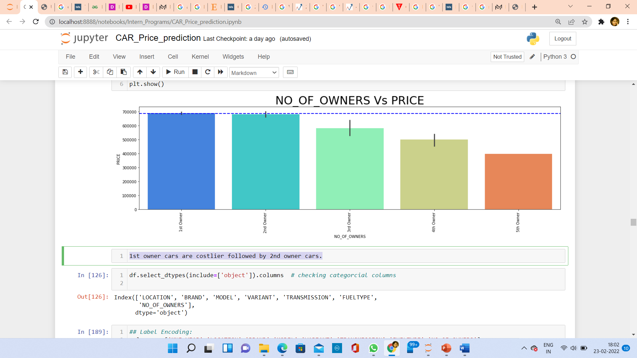
Visualization(Bi-Variate Analysis)
Observations:
1st owner cars are costlier followed by 2nd owner cars.

Slide 22
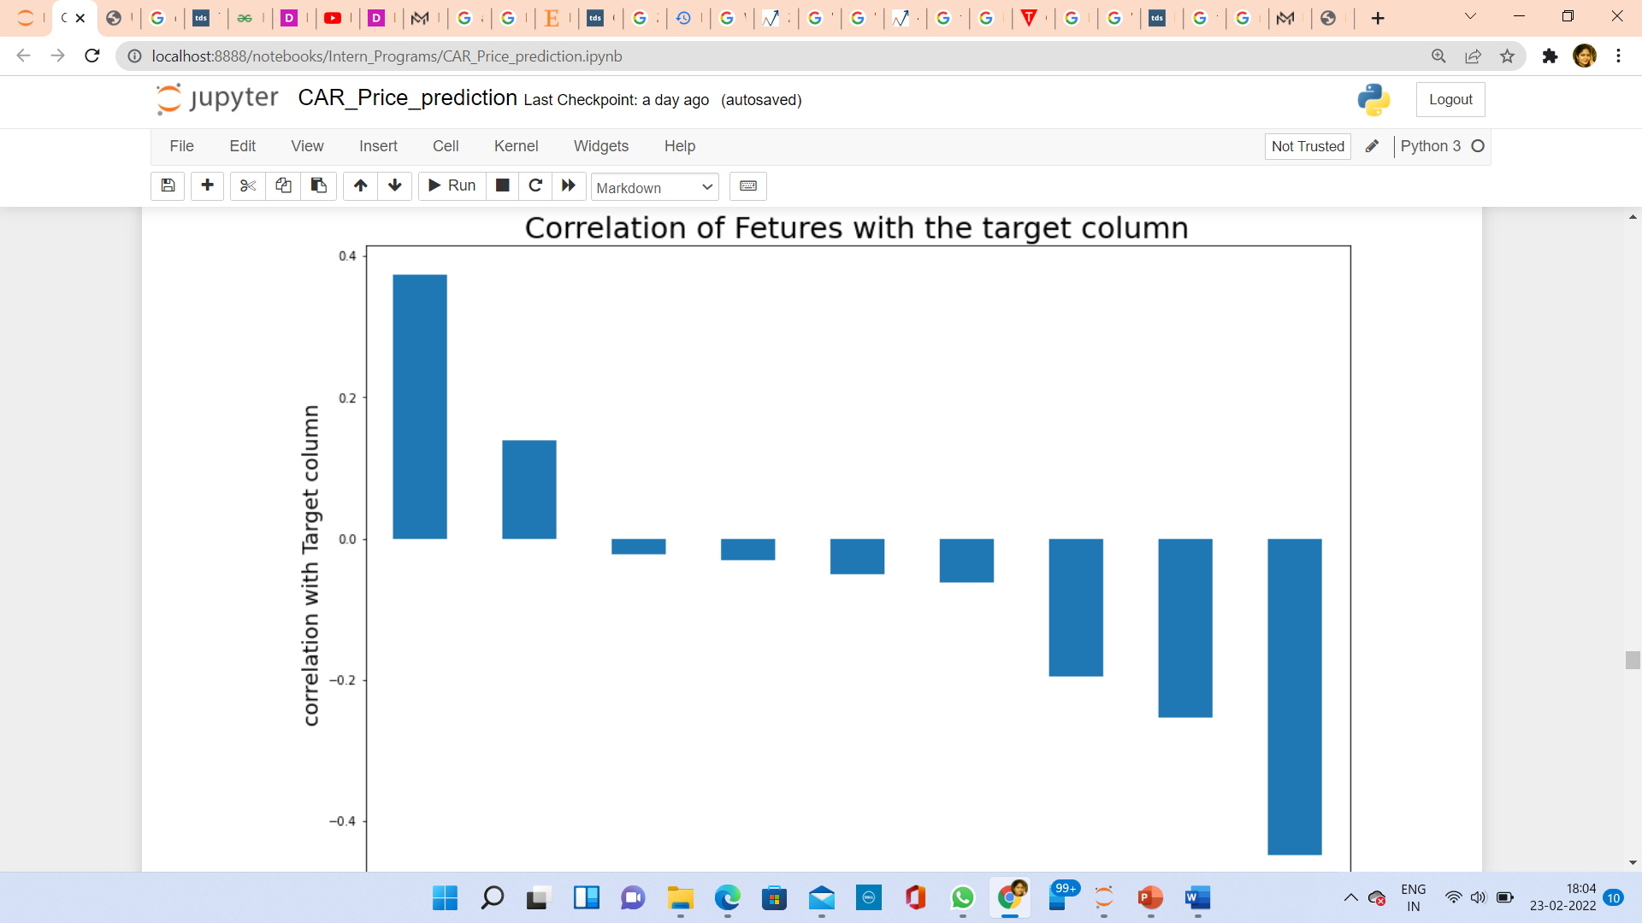
Correlation
Observations:
MNF_YEAR and LOCATION have positive relationship with Target.
MODEL,NO_OF_OWNERS,DRIVEN_KM,BRAND,VARIANT, FUELTYPE,TRANSMISSION have negative correlation with Target.

Slide 23
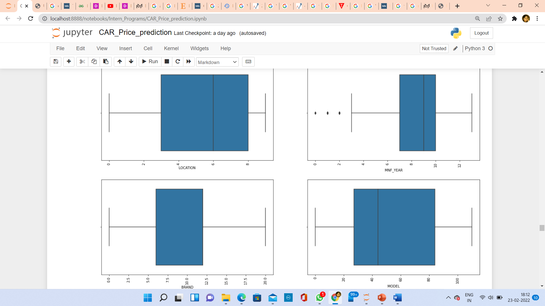
Outliers
Outlier detection using boxplot

Slide 24
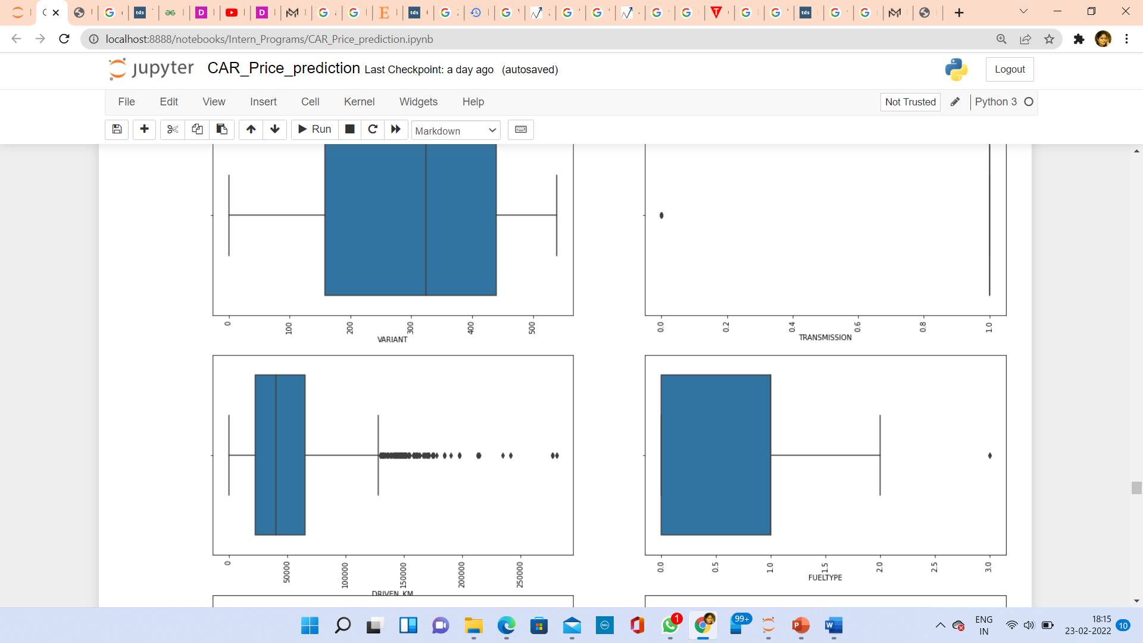
Outliers
DRIVEN_KM has outliers.

Slide 25
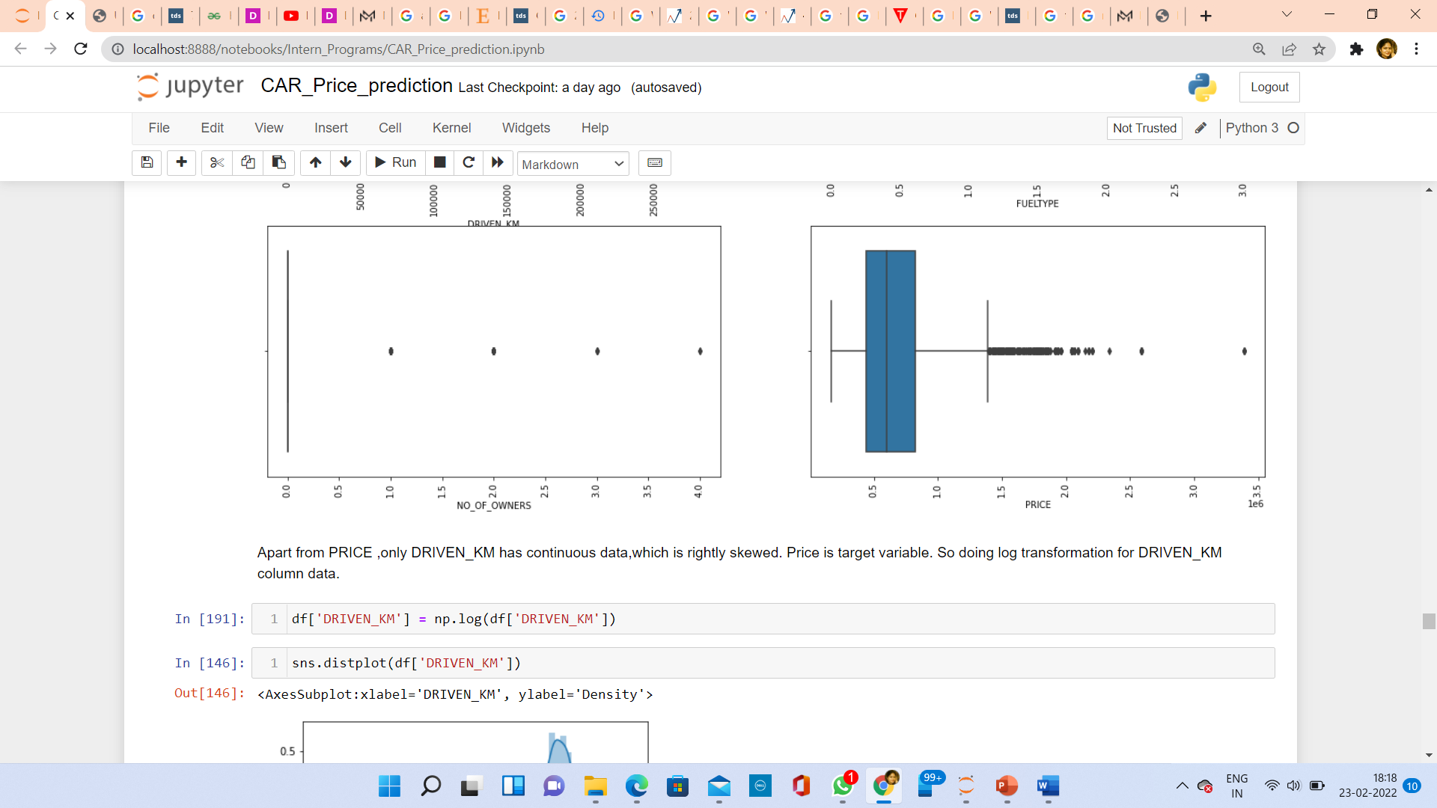
Outliers
Observations:
Apart from PRICE ,only DRIVEN_KM has continuous data, which is rightly skewed. Price is target variable. So doing log transformation for DRIVEN_KM column data.

Slide 26
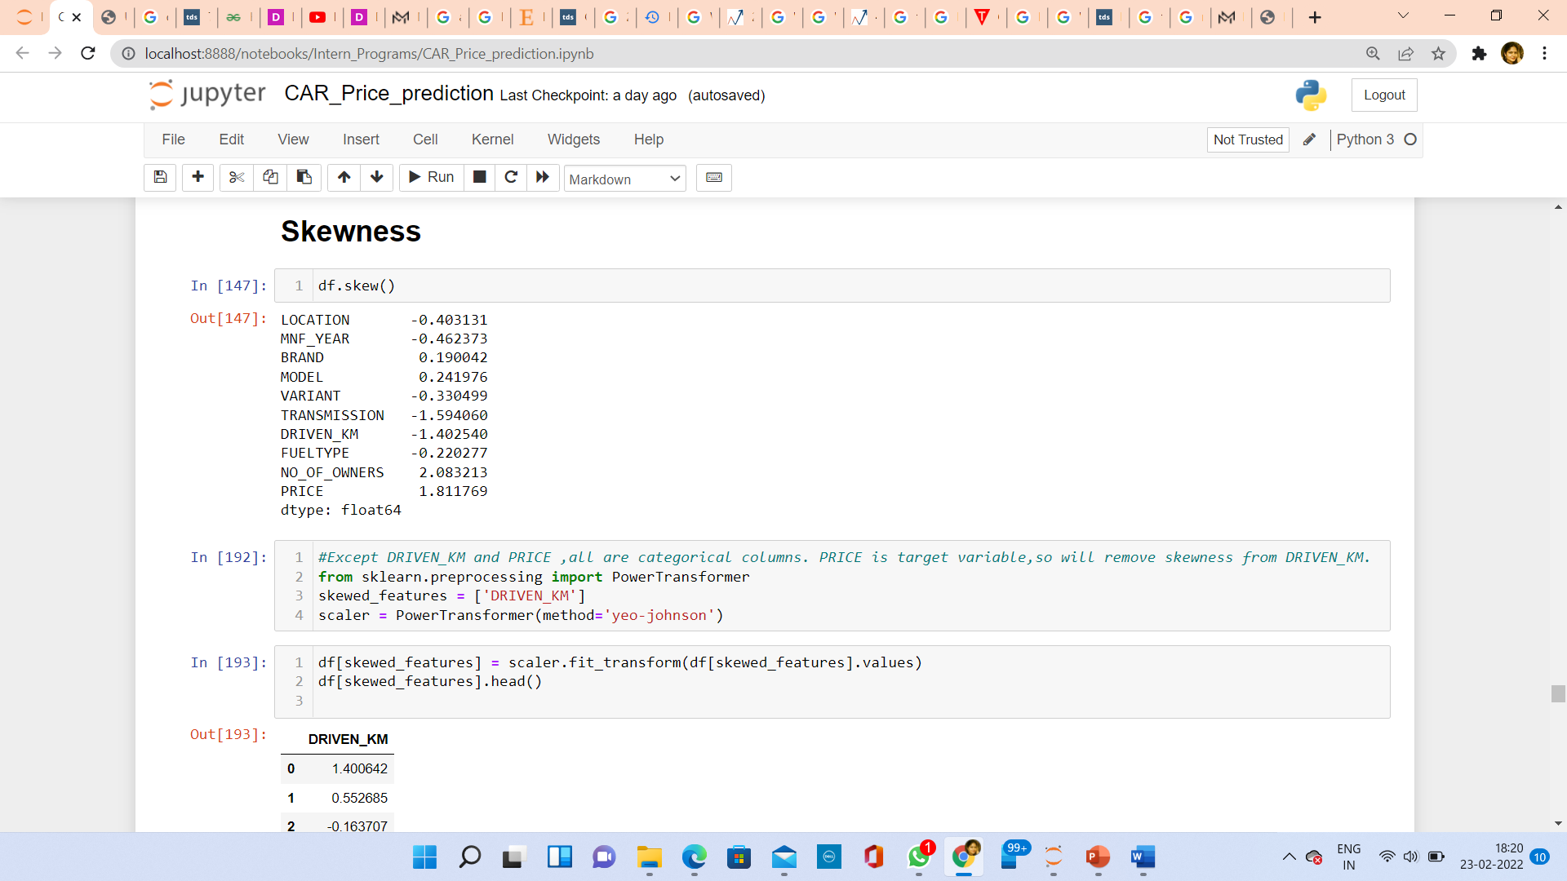
Skewness
Only TRANSMISSION, DRIVEN_KM, NO_OF_OWNERS and PRICE are out of range +/- 0.5.
TRANSMISSION and NO_OF_OWNERS are categorical column. So no need to remove skewness. PRICE is target column,
So no need to remove skewness, So I have removed skewness only from DRIVEN_KM.

Slide 27
Outlier Removal
Since my dataset is not very big and only DRIVEN_KM column has shown some outliers, SO only for that column I have done log transformation.

Slide 28
Standardization
To generalize/standardize our data, first I have splitted my data between features and label.
I have generalized data using StandardScaler method.

Slide 29
Model Building
Since our label data is continuous,So this is a regression problem.
I have chosen following Regression models to build model:
a)Linear Regression
b)Random Forest Regressor
c)KNeighbors Regressor
d)AdaBoost Regressor
e)DecisionTree Regressor
f) Lasso
g)Ridge

Slide 30
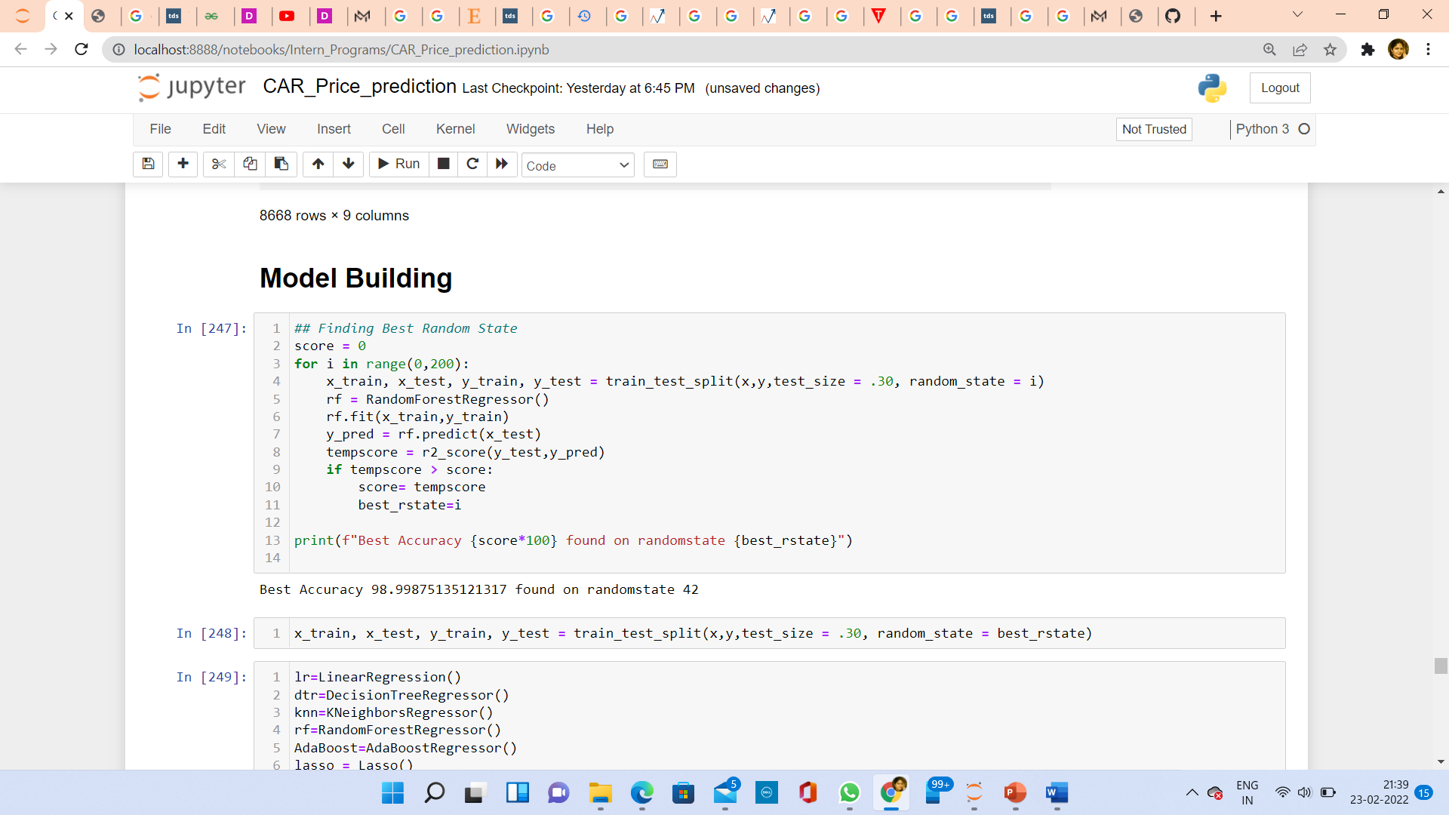
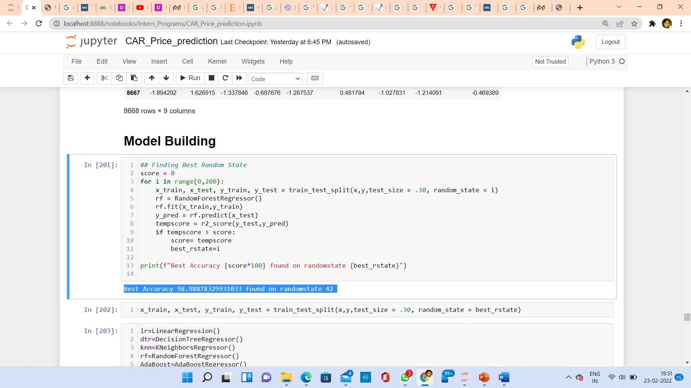
Finding Best Random State and Splitting data between Train and Test Data
Best Random state 98.99 found on random state 42.

Slide 31
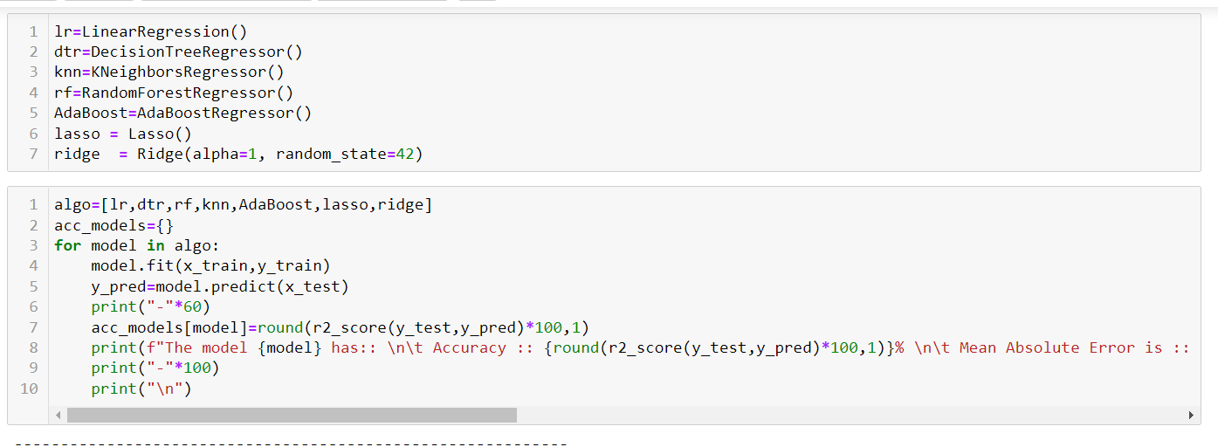
Model Initialisation ,Training of model, and Predicting Target data

Slide 32
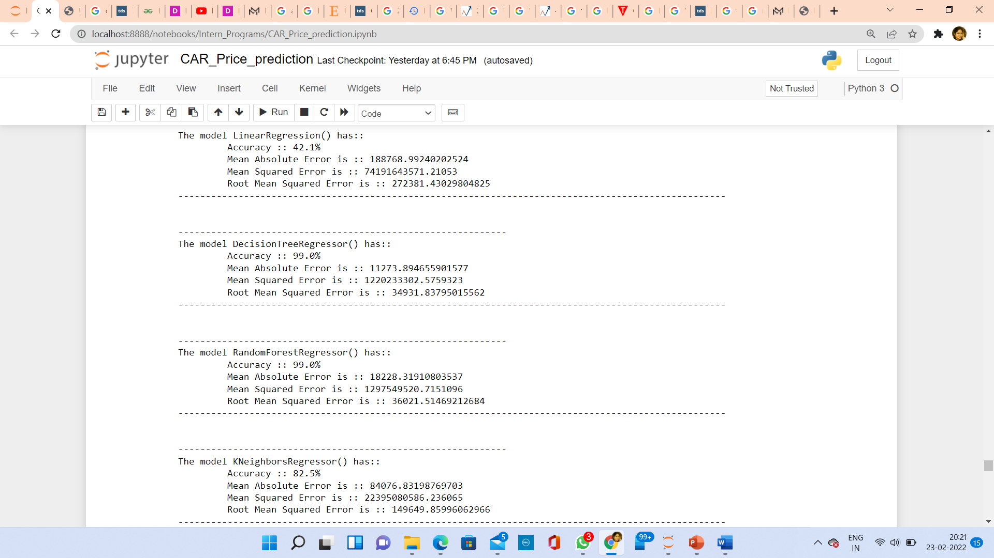
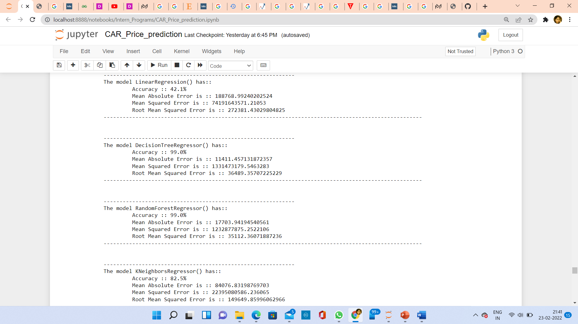
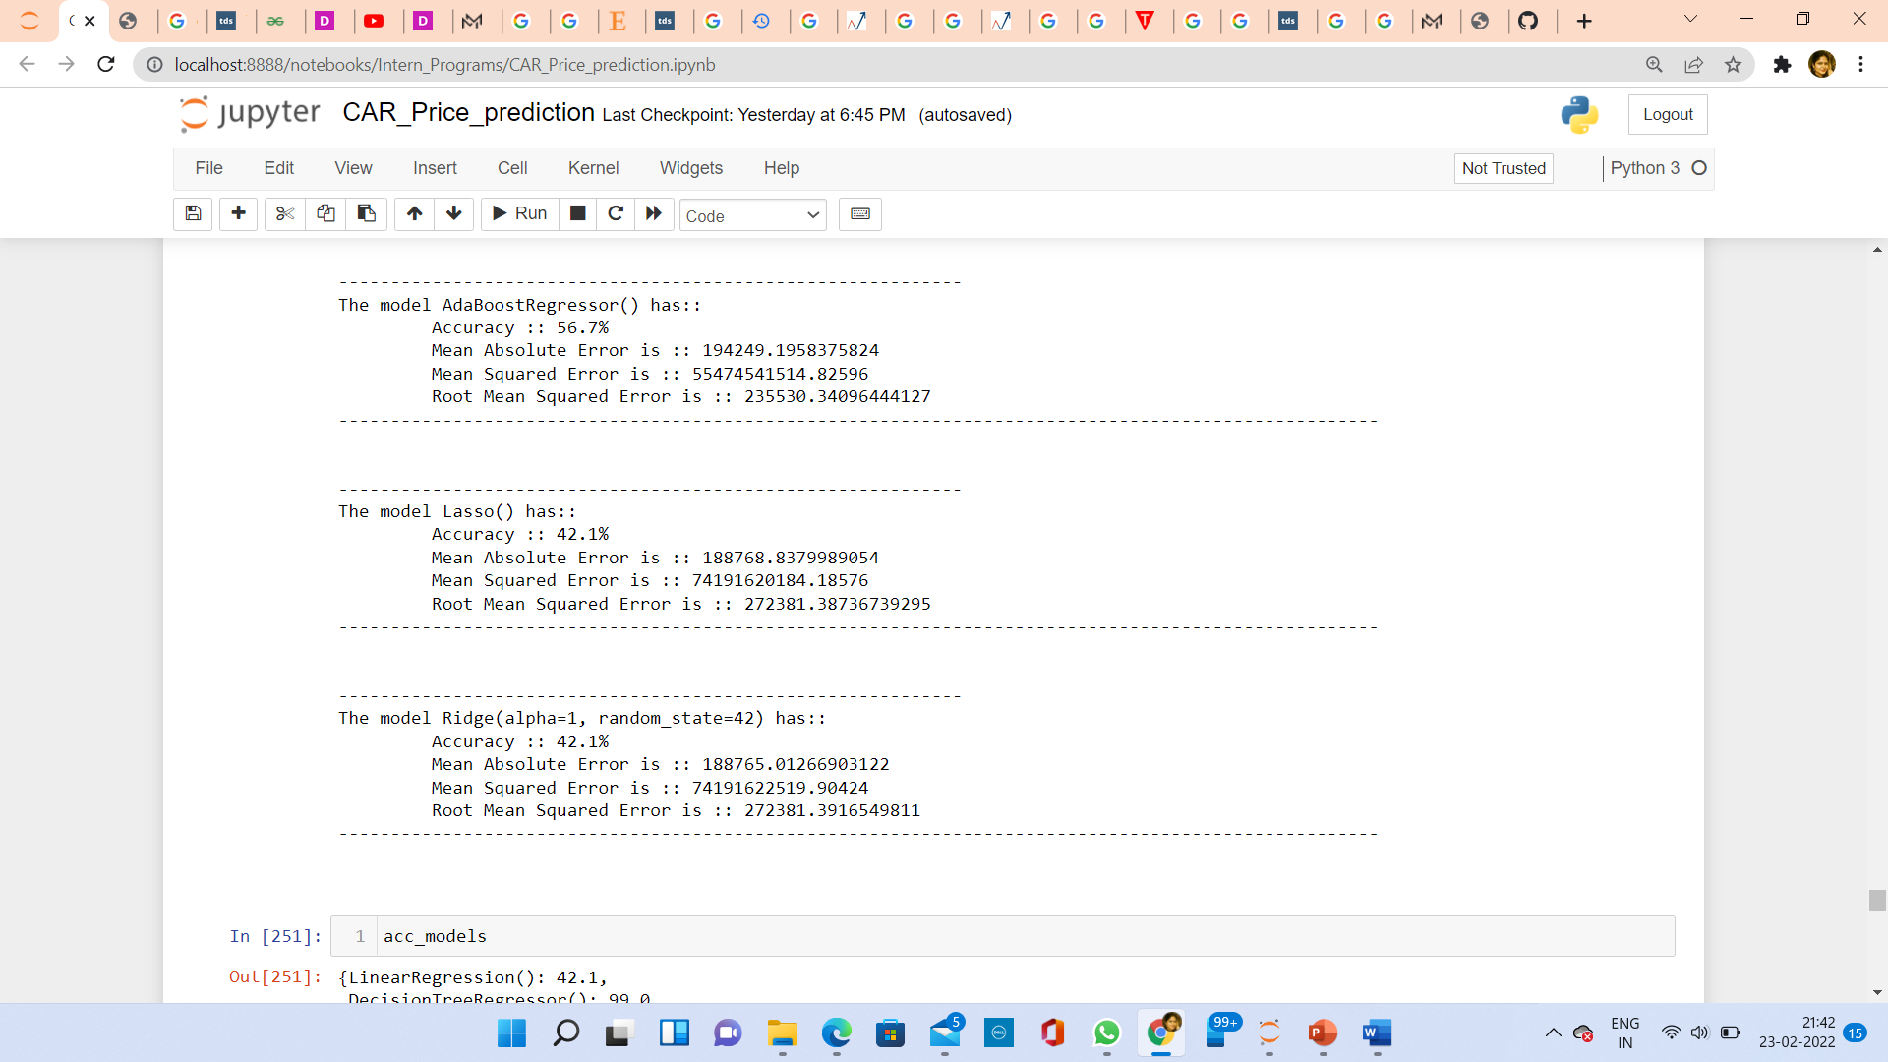
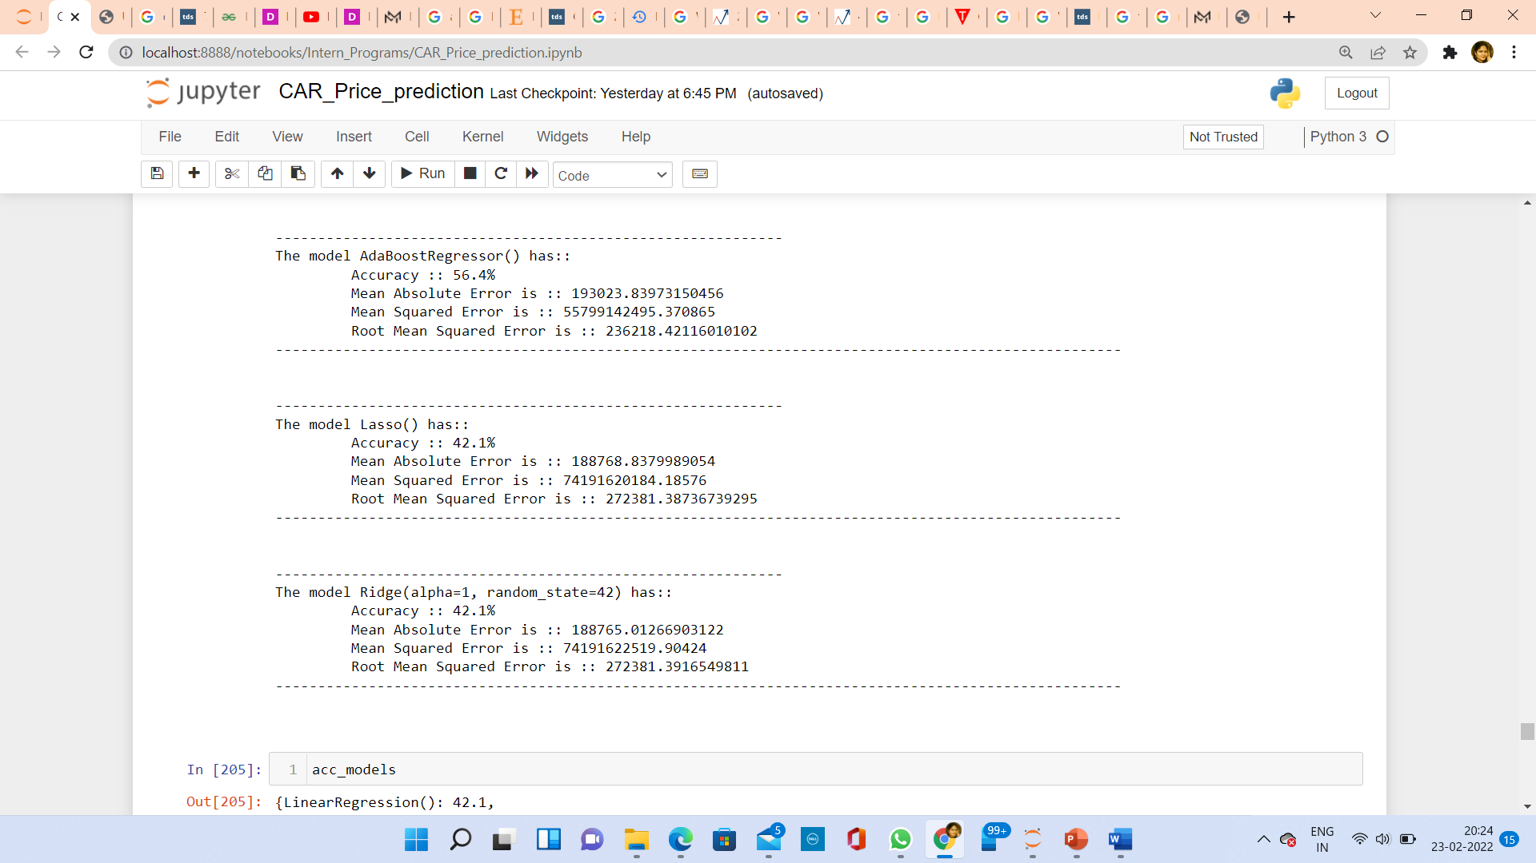
Key metrics used for evaluation of models

Slide 33
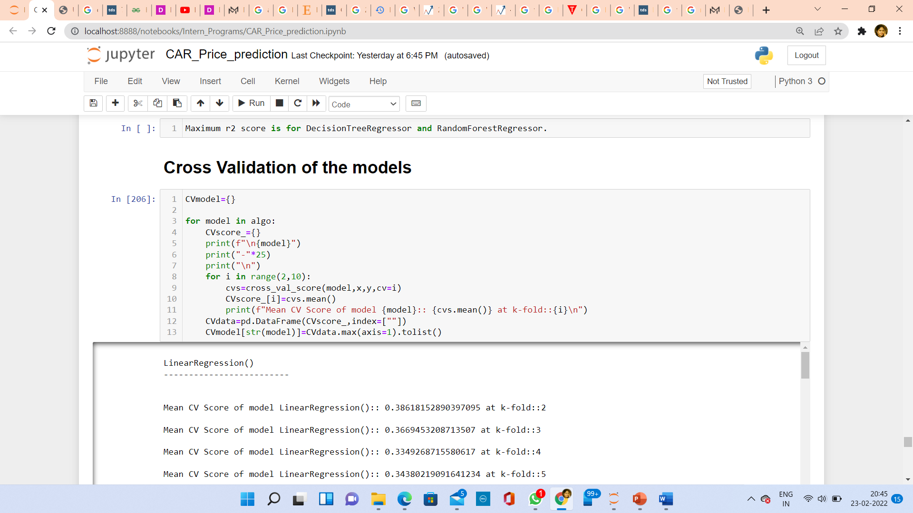
Cross Validation of the Models

Slide 34
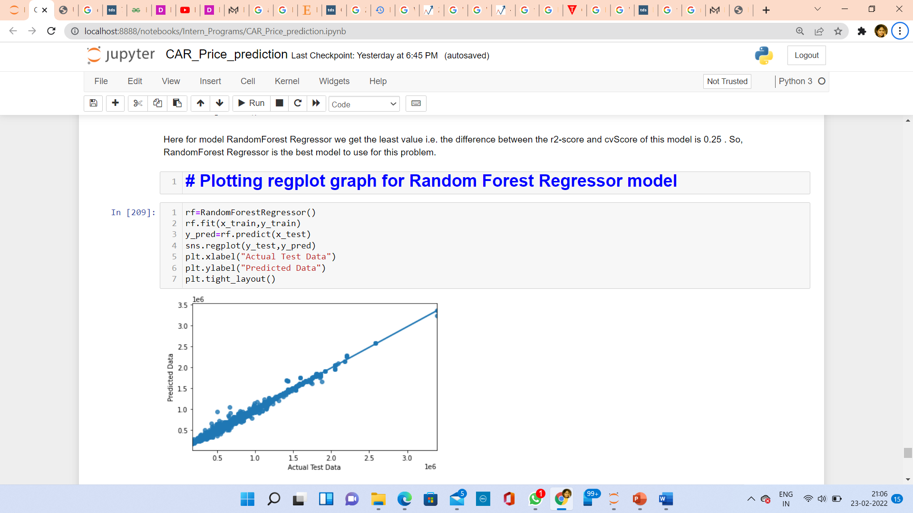
Plotting Regplot for Random Forest Regressor

Slide 35
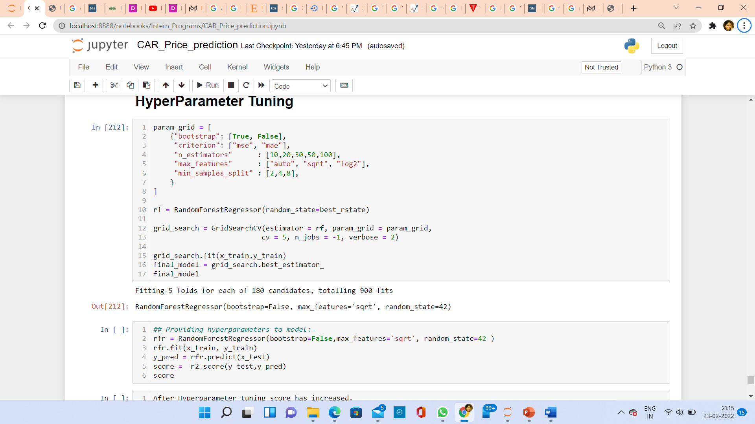
Hyper Parameter Tuning
Cross validation score of Random Forest Model is Highest amongst all other models, So I have done Hyper Parameter tuning for Random Forest model.After tuning score increased to 99.39.

Slide 36
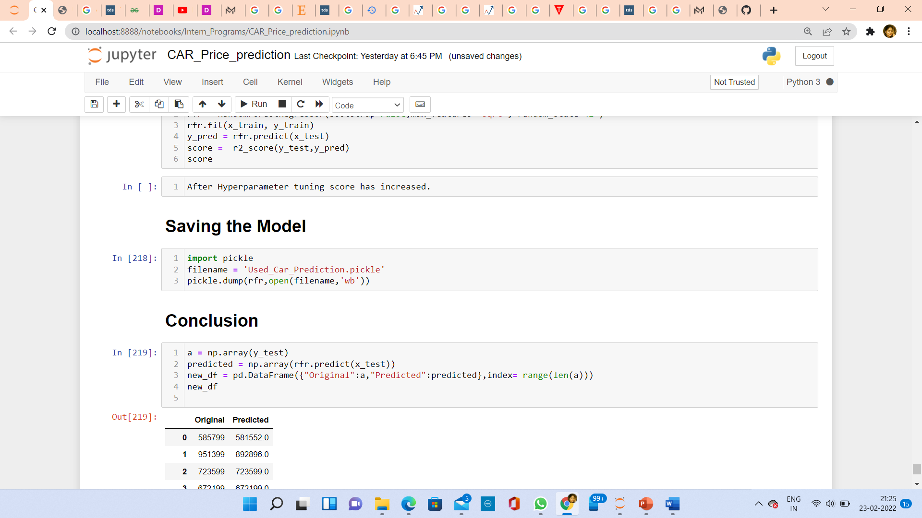
Saving model

Slide 37
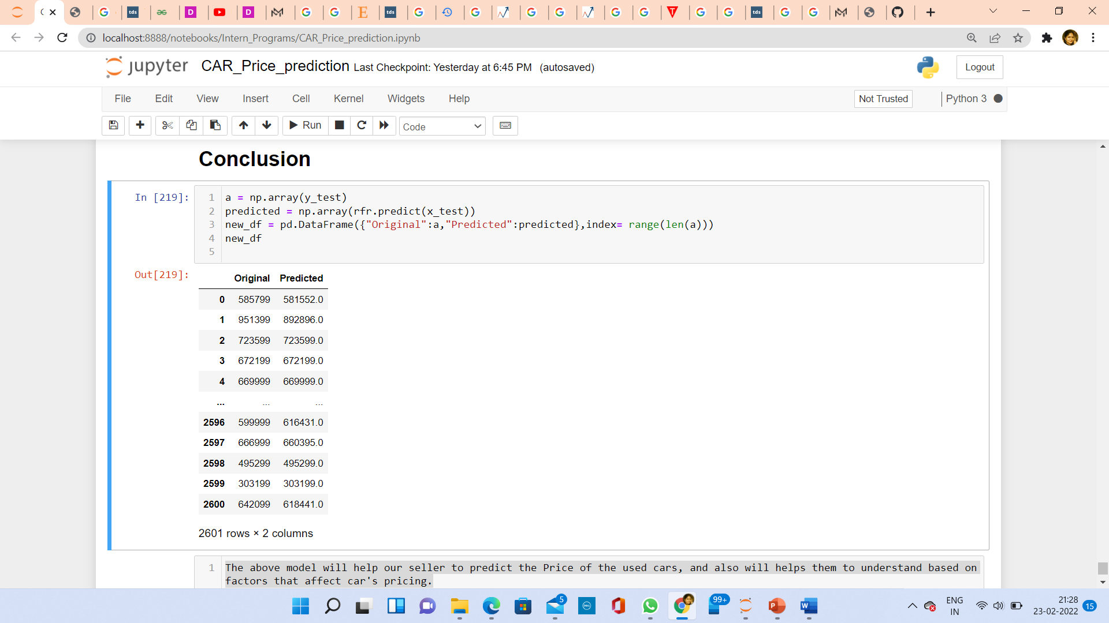
Conclusion

Slide 38
Limitations
Dataset is not very big, we can collect more data and other different features to make a model which can predict used car’s price.

